Slide 1


Engineering Complex Behaviors in Biological Organisms
Jacob Beal
University of Iowa
December, 2015

Slide 2
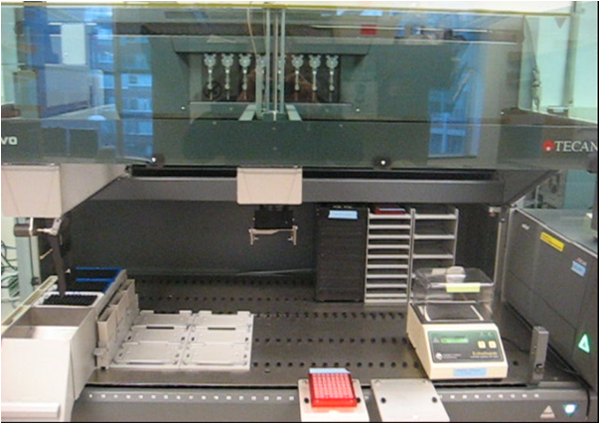


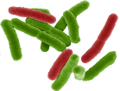


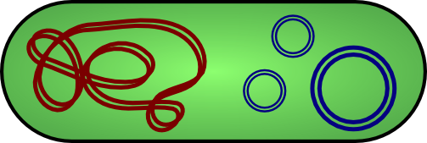
Vision: WYSIWYG Organism Engineering
Bioengineering should be like document preparation:

Slide 3
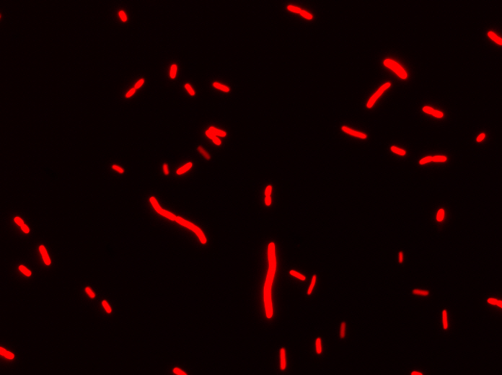
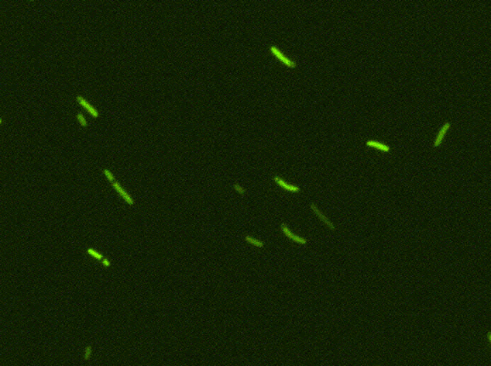
Focus: Genetic Circuits
Ara
AraC
pBAD
GFP
pBAD
TetR
pTet
RFP
No Arabinose
High Dose Arabinose
Notes:
as opposed to other areas like enzyme engineering, tissue engineering, metabolic engineering

Slide 4
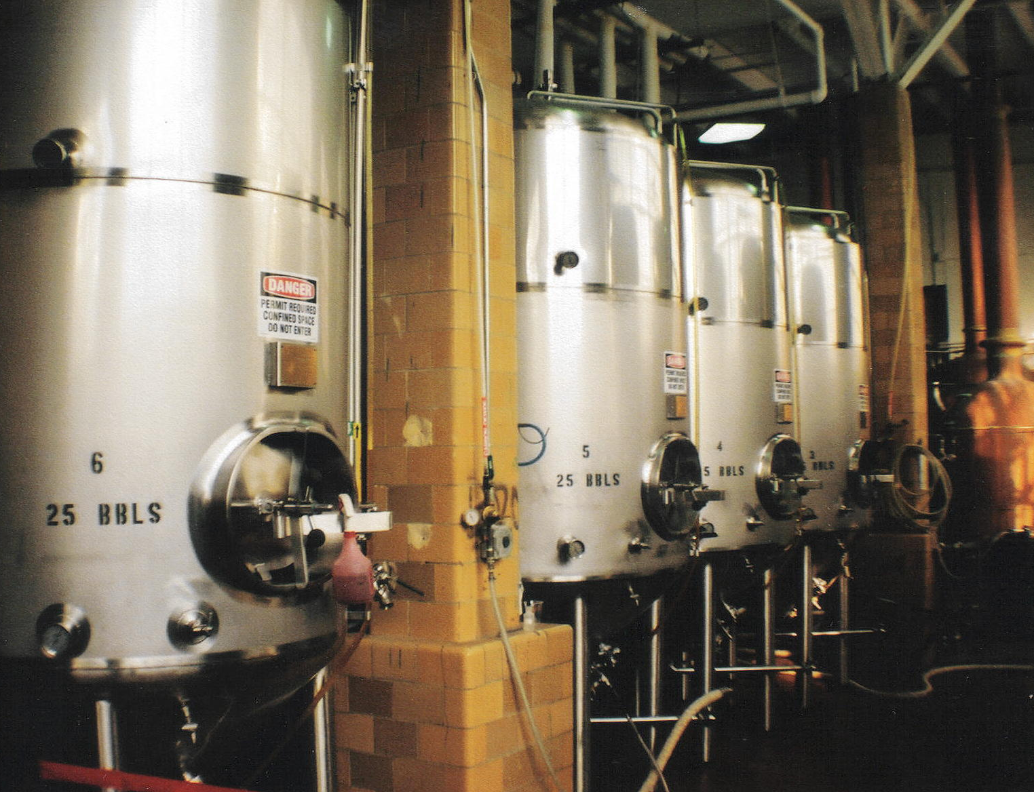
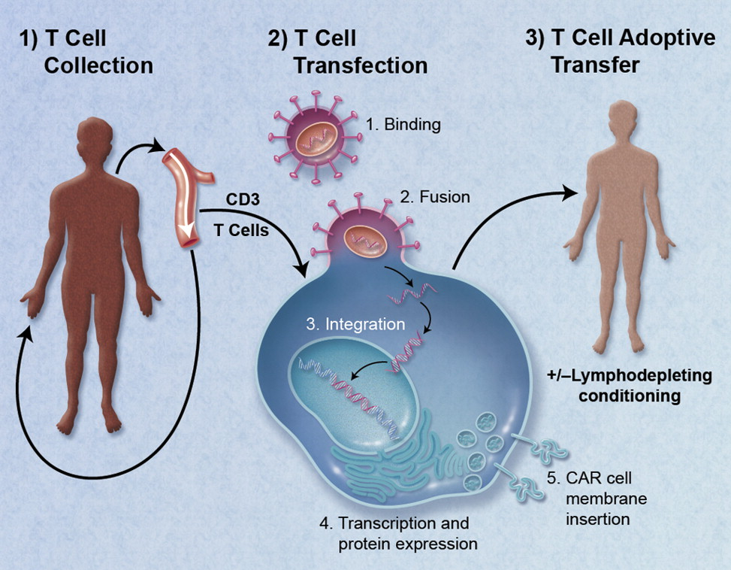
Example genetic circuit applications
Fermentation control
CAR T-cell Therapy

Slide 5

High-Level Genetic Circuit Design
Make drug when Arabinose shows up before IPTG

Slide 6
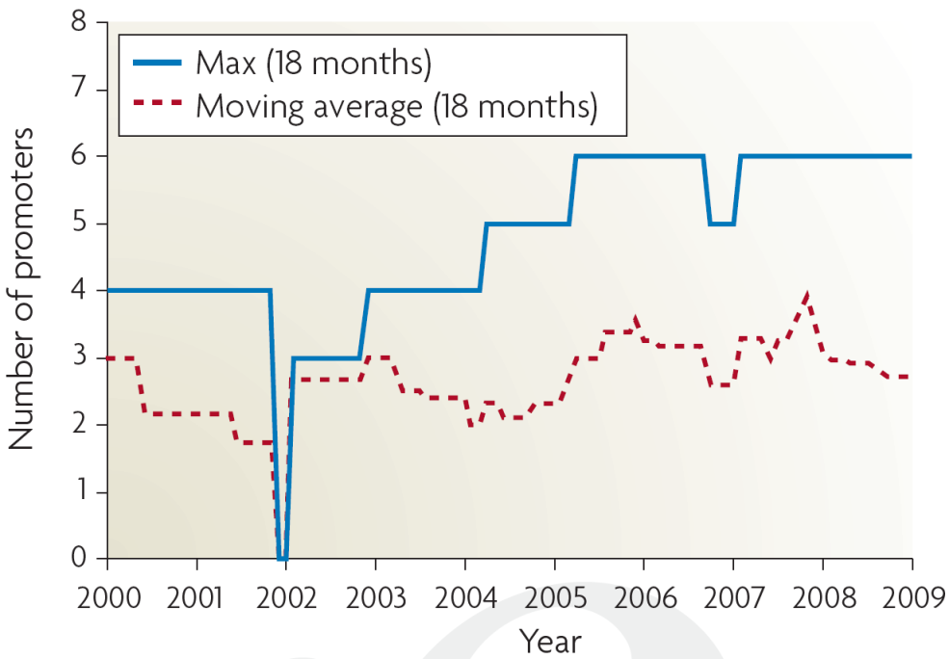
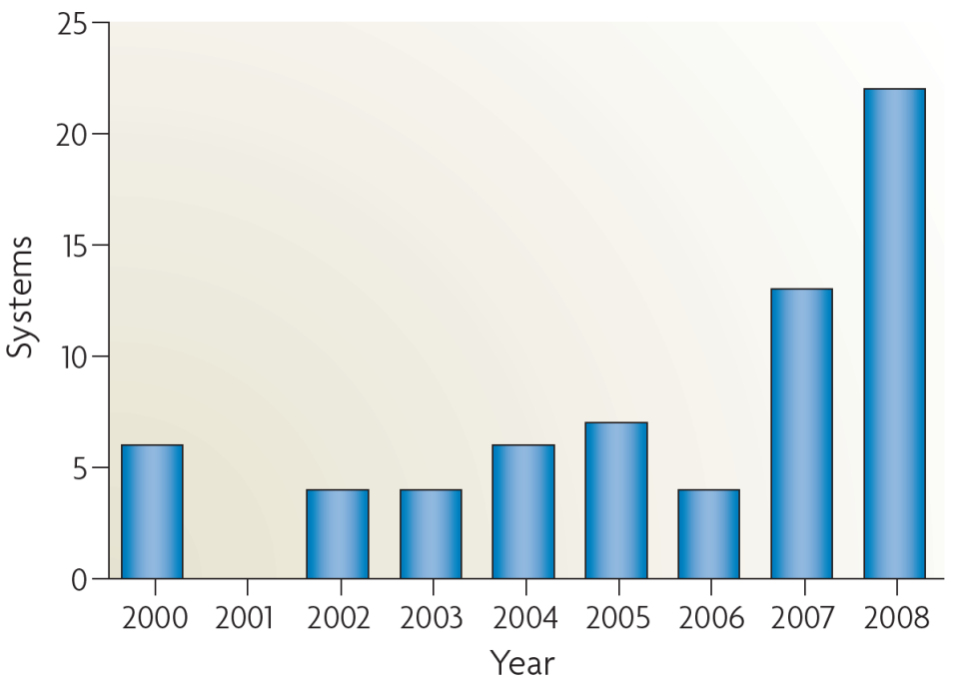
Why is this important?
Breaking the complexity barrier:
Multiplication of research impact
Reduction of barriers to entry
?
DNA synthesis
Circuit size
[Purnick & Weiss, ‘09]
*Sampling of systems in publications with experimental circuits

Slide 7
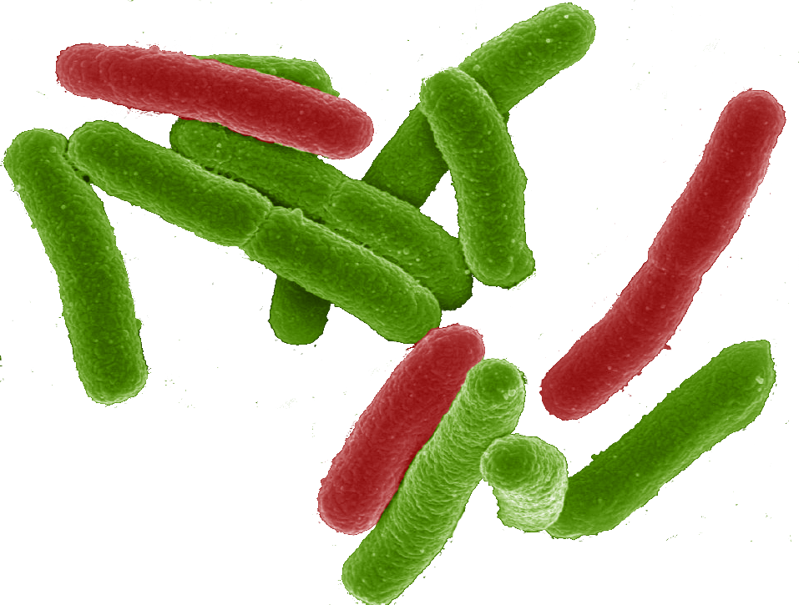
Why a tool-chain?
Organism Level Description
This gap is too big to cross with a single method!
Cells

Slide 8
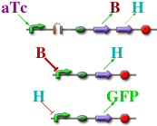
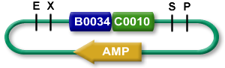

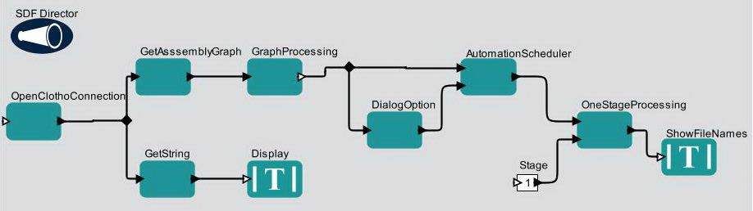

TASBE tool-chain
Organism Level Description
High level simulator
High Level Description
If detect explosives:
emit signal
If signal > threshold:
glow red
Coarse chemical simulator
Abstract Genetic Regulatory Network
Detailed chemical simulator
DNA Parts Sequence
Modular architecture also open for flexible choice of organisms, protocols, methods, …
Collaborators:
Assembly Instructions
Ron
Weiss
Testing
Douglas Densmore
Cells
[Beal et al, ACS Syn. Bio. 2012]

Slide 9
A Tool-Chain Example
A high-level program of a system that reacts depending on sensor output
If detect explosives:
emit signal
If signal > threshold:
glow red
(def simple-sensor-actuator ()
(let ((x (test-sensor)))
(debug x)
(debug-2 (not x))))
Mammalian Target
E. coli Target
[Beal et al, ACS Syn. Bio. 2012]

Slide 10
A Tool-Chain Example
Program instantiated for two target platforms
If detect explosives:
emit signal
If signal > threshold:
glow red
Mammalian Target
E. coli Target
[Beal et al, ACS Syn. Bio. 2012]

Slide 11
A Tool-Chain Example
Abstract genetic regulatory networks
If detect explosives:
emit signal
If signal > threshold:
glow red
Mammalian Target
E. coli Target
[Beal et al, ACS Syn. Bio. 2012]

Slide 12
A Tool-Chain Example
Automated part selection using database of known part behaviors
If detect explosives:
emit signal
If signal > threshold:
glow red
Mammalian Target
E. coli Target
[Beal et al, ACS Syn. Bio. 2012]

Slide 13
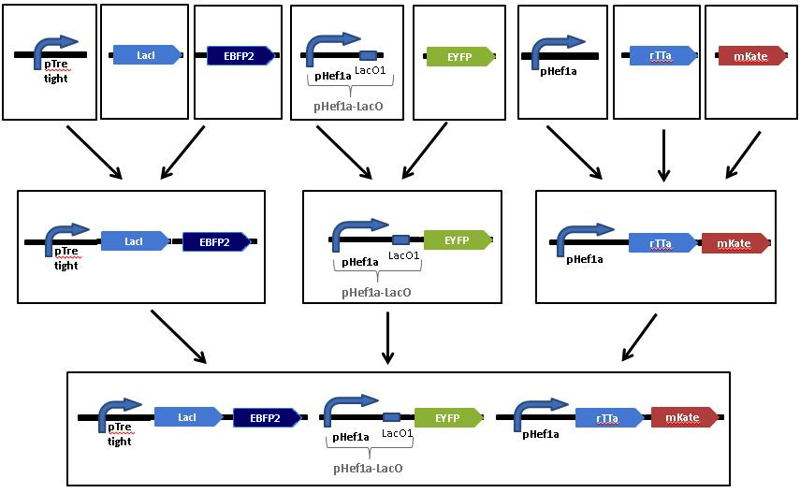
A Tool-Chain Example
Automated assembly step selection for two different platform-specific assembly protocols
If detect explosives:
emit signal
If signal > threshold:
glow red
Mammalian Target
E. coli Target
[Beal et al, ACS Syn. Bio. 2012]

Slide 14
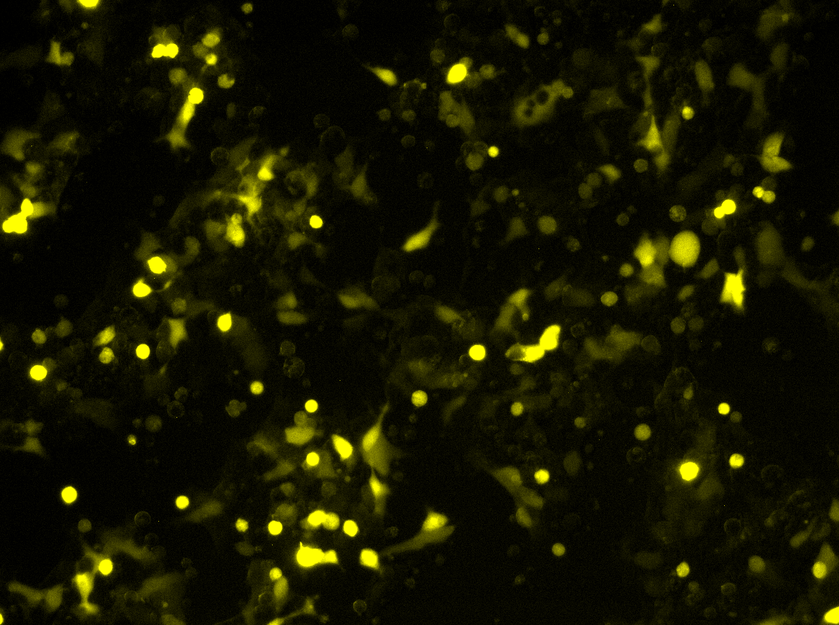
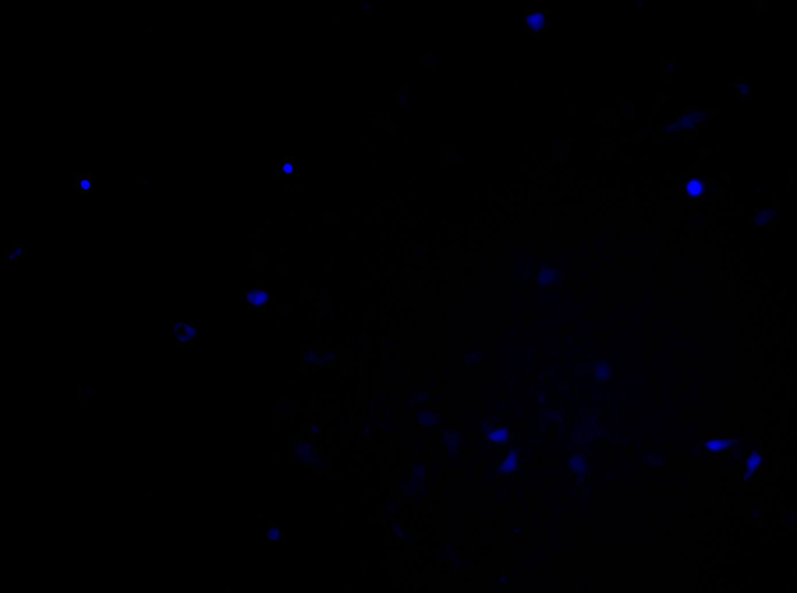
A Tool-Chain Example
Resulting cells demonstrating expected behavior
Uninduced
Uninduced
If detect explosives:
emit signal
If signal > threshold:
glow red
Induced
Induced
Mammalian Target
E. coli Target
[Beal et al, ACS Syn. Bio. 2012]

Slide 15

Synthetic Biology Open Language
FASTA
GenBank
SBOL 1.1
SBOL 2.0
ACTGTGCCGTTAAACGTGATTAAATCCGTACTGATAT…
TetR
GFP
pTet
aTc detector
GFP reporter
TetR
GFP
pTet
aTc detector
aTc
GFP reporter
TetR
GFP
TetR
GFP
pTet

Slide 16
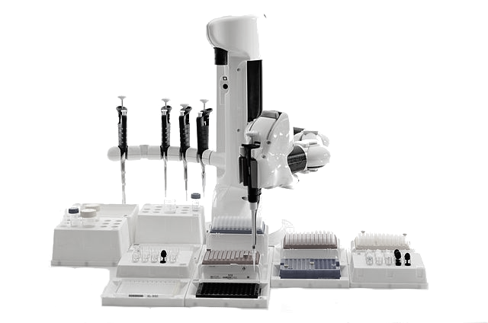



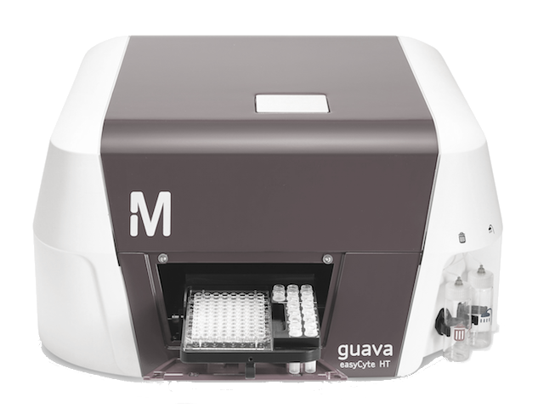









SBOL supports bio-design interchange
Lots of different synthetic biology resources…
Repositories & Databases
Automation & Integration
Lab Automation
LIMS
GenBank
HT Assays
Modeling
Emerging Approaches
Sequencing & Synthesis
SO
Strain Data
BioPAX
ChEBI
BioModels.Net
Measurement Data
… SBOL is a "hub" for linking them together
Notes:
SBOL 2.0 describes sequence, plus just enough information about function to provide hooks for integrating a broad range of resources together.

Slide 17
High-Level Design: BioCompiler
Organism Level Description
Compilation &
Optimization
High level simulator
High Level Description
If detect explosives:
emit signal
If signal > threshold:
glow red
Coarse chemical simulator
Abstract Genetic Regulatory Network
Detailed chemical simulator
DNA Parts Sequence
Other tools aiming at
high-level design:
Cello, Eugene, GEC,
GenoCAD, etc.
Assembly Instructions
Testing
Cells
[Beal, Lu, Weiss, 2011]

Slide 18
Motif-Based Compilation
High-level primitives map to GRN design motifs
e.g. logical operators:
(primitive not (boolean) boolean
:grn-motif ((P high R- arg0 value T)))
arg0
value

Slide 19
Motif-Based Compilation
High-level primitives map to GRN design motifs
e.g. logical operators, actuators:
(primitive green (boolean) boolean :side-effect
:type-constraints ((= value arg0))
:grn-motif ((P R+ arg0 GFP|arg0 value T)))
arg0
GFP
value

Slide 20
Motif-Based Compilation
High-level primitives map to GRN design motifs
e.g. logical operators, actuators, sensors:
(primitive IPTG () boolean
:grn-motif ((P high LacI|boolean T)
(RXN (IPTG|boolean) represses LacI)
(P high R- LacI value T)))
IPTG
LacI
value

Slide 21
Motif-Based Compilation
Functional program gives dataflow computation:
(green (not (IPTG)))
IPTG
not
green

Slide 22
Motif-Based Compilation
Operators translated to motifs:
IPTG
not
green
IPTG
A
B
LacI
outputs
arg0
outputs
arg0
GFP
outputs
IPTG
LacI
A
B
GFP

Slide 23
Optimization
IPTG
LacI
A
B
GFP
Copy Propagation
IPTG
LacI
A
B
GFP
Dead Code Elimination
IPTG
LacI
A
GFP
Dead Code Elimination
IPTG
LacI
A
GFP

Slide 24
Design Optimization
(def one-bit-memory(set reset)
(letfed+ ((o boolean (not (or reset o-bar)))
(o-bar boolean (not (or set o))))
o))
(green (one-bit-memory (aTc) (IPTG)))
IPTG
GFP
LacI
B
I
F
E1
E2
D
I
aTc
C
J
H
G
TetR
A
J
Unoptimized: 15 functional units, 13 transcription factors

Slide 25
Design Optimization
(def one-bit-memory(set reset)
(letfed+ ((o boolean (not (or reset o-bar)))
(o-bar boolean (not (or set o))))
o))
(green (one-bit-memory (aTc) (IPTG)))
IPTG
F
GFP
H
LacI
TetR
aTc
Final Optimized:
5 functional units
4 transcription factors
H
F
Unoptimized: 15 functional units, 13 transcription factors

Slide 26
Complex Example: 4-bit Counter
Optimized compiler already outperforms human designers

Slide 27
The Tool-Chain Approach:
Organism Aggregate Description
Proto
BioCompiler
High level simulator
Single-Cell Description
If detect explosives:
emit signal
If signal > threshold:
glow red
[Beal et al, PLoS ONE 2011]
Coarse chemical simulator
Alternate 2nd stages:
SBROME, CELLO, GEC, …
Abstract Genetic Regulatory Network
Gap!
Detailed chemical simulator
DNA Parts Sequence(s)
Assembly Instructions
Next-Gen Synthesis,
Organick, Antha, MAGE,
microfluidics, …
Testing
Cells

Slide 28
Complex Designs: Barriers & Emerging Solutions
Barrier: Characterization of Devices
Emerging solution: TASBE characterization method
Barrier: Predictability of Biological Circuits
Emerging solution: EQuIP prediction method
Barrier: Availability of High-Gain Devices
Emerging Solution: combinatorial device libraries based on CRISPR, TALs, miRNAs, recombinases, …

Slide 29

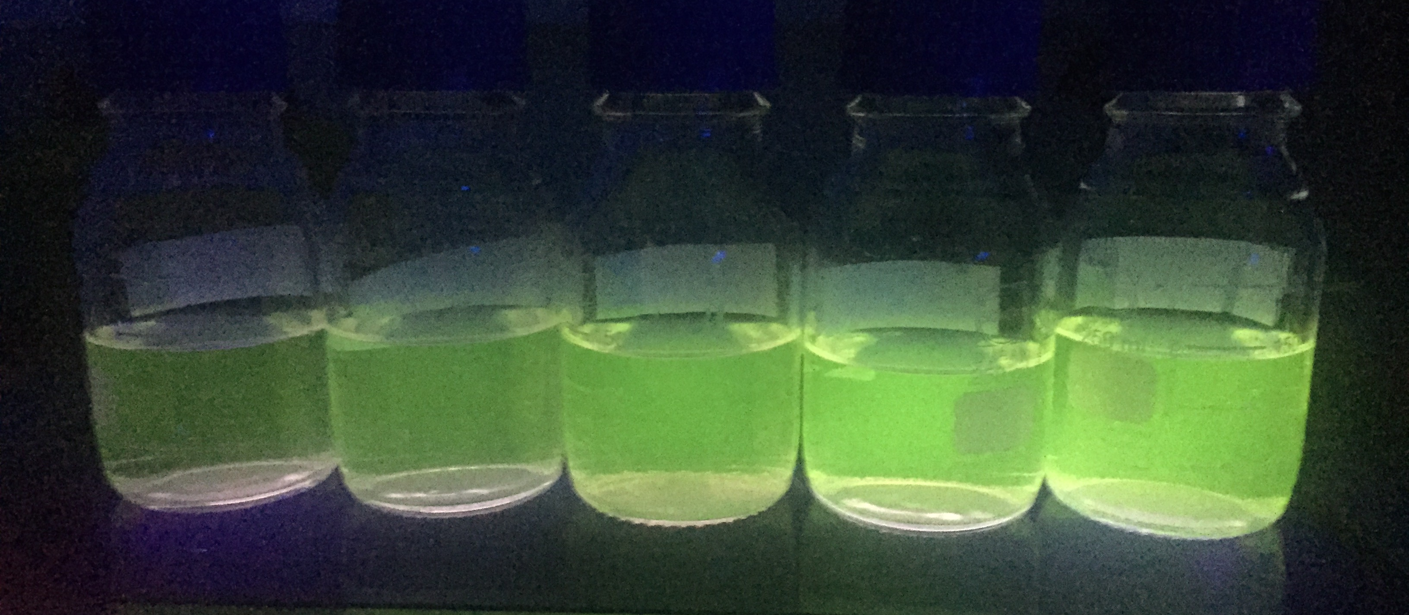
Characterization & reproducibility
iGEM Interlab Study:
Build three constitutive GFP constructs
Culture & measure fluorescence
3 biological replicates (Extra: x 3 technical rep.)
Negative
(e.g. R0040)
J23117
+ I13504
Positive
(e.g. I20270)
J23106
+ I13504
J23101
+ I13504
Image from iGEM Oxford 2015

Slide 30
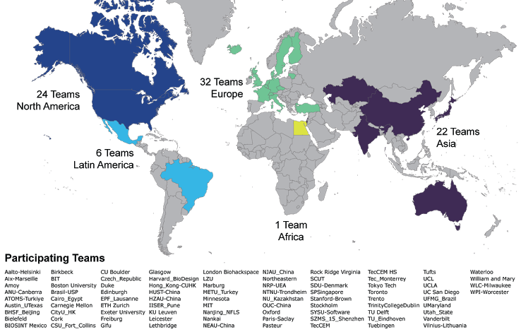
2015 iGEM Interlab Study Participation

Slide 31
High precision possible
Mean ratio = 2.36
Std.dev. = 1.54-fold

Slide 32
Instrument issues drive variation!
Strain
Instrument
1000
100
10
1

Slide 33
Calibrated Flow Cytometry
[Roederer, 2002; Wang et al., 2008; NIST/ISAC, 2012; Beal et al., 2012; Kiani et al., 2014; Beal et al., 2014; Davidsohn et al, 2014]

Slide 34
Example: Predicting Repressor Cascades
Precision dose-response measurement allows high-precision prediction with quantitative models
Dox
pCAG
rtTA3
T2A
VP16Gal4
pTRE
EBFP2
pCAG
R1
R2
EYFP
pCAG
mkate
pTRE
pUAS-Rep1
pUAS-Rep2
Prediction of Repressor Cascade
Range vs. Error for 6 Cascades
TAL14 → TAL21
+: experimental
o: predicted
Each line is a dose/response curve for a different relative number of circuit copies.
Subpopulation identified by color on inset mKate histogram
[Davidsohn et al., 2014]

Slide 35
How much does calibration matter?
8x tighter
range just by
calibration!
(2.8x better high errors,
2.8x better low errors)
[Davidsohn et al., submitted]

Slide 36
Example: Engineering Replicon Expression
Per-cell measurement of dose-response gives model allowing high-precision control of expression
Example:
Prediction of fluorescence vs. time for novel mixtures of 3 Sindbis RNA replicons
nsP1-4
SGP
mVenus
Mix 1: 0.1Y, 0.1R, 0.1B
Mix 2: 0.3Y, 0.3R, 0.3B
Mix 3: 0.1Y, 0.5R, 0.4B
Mix 4: 0.2Y, 0.2R, 0.6B
Mix 5: 0.01Y, 0.1R, 0.5B
Mix 6: 0.4Y, 0.02R, 0.02B
nsP1-4
SGP
mKate
nsP1-4
SGP
EBFP2
Example Prediction of 3-RNA Replicon Mix:
Range vs. Error for 6 Mixtures
Mix Number
[Beal et al., 2014]

Slide 37
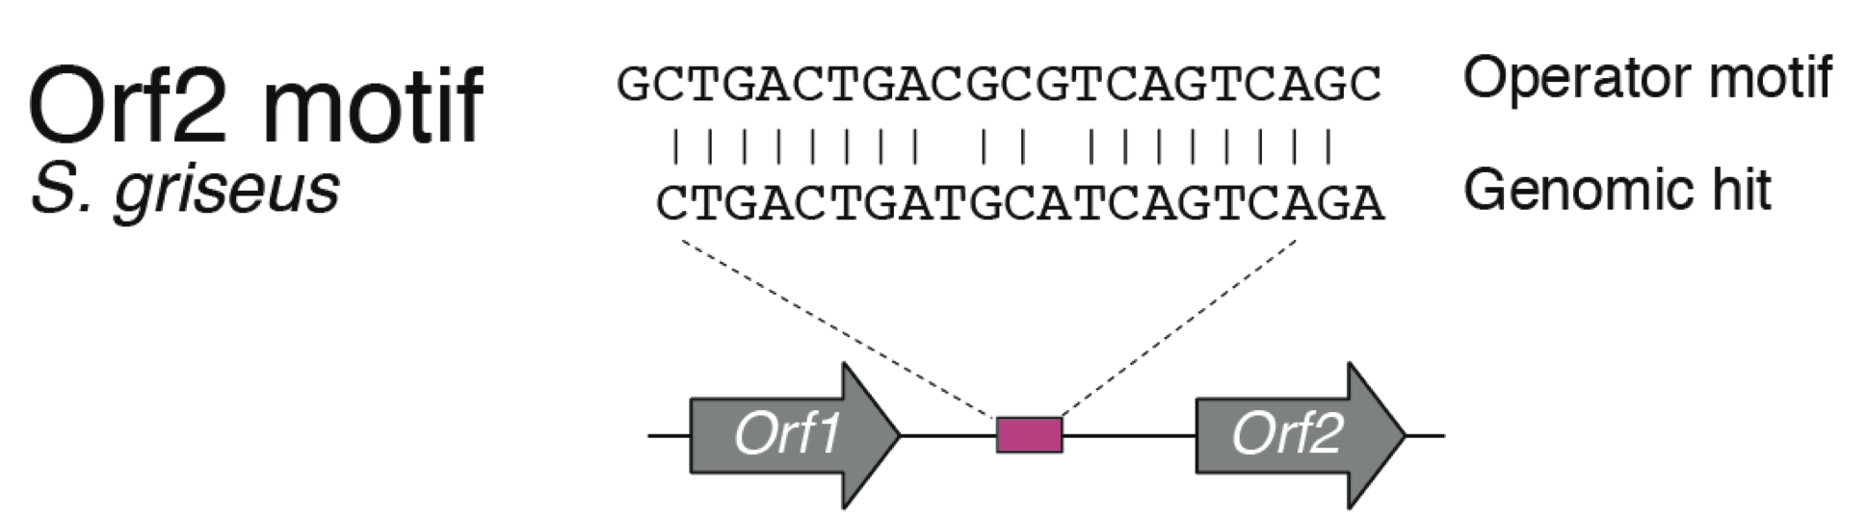
High-performance device libraries
TetR Homologs
Variable on/off
Variable amplification
ΔSNR ~0
[Stanton et al. 2014]
Best Possible ΔSNR:
Transfer Curves:
Only 4 devices can have SNR>0
Few good input/output matches

Slide 38
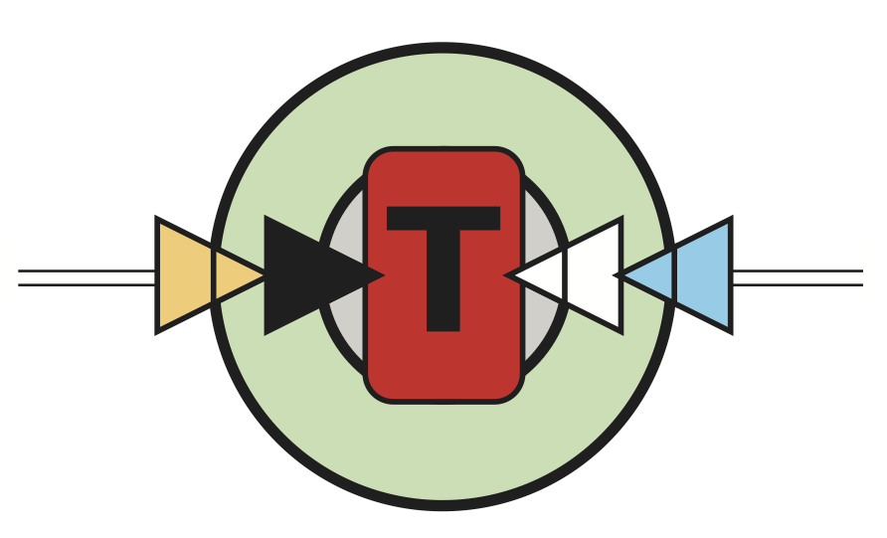
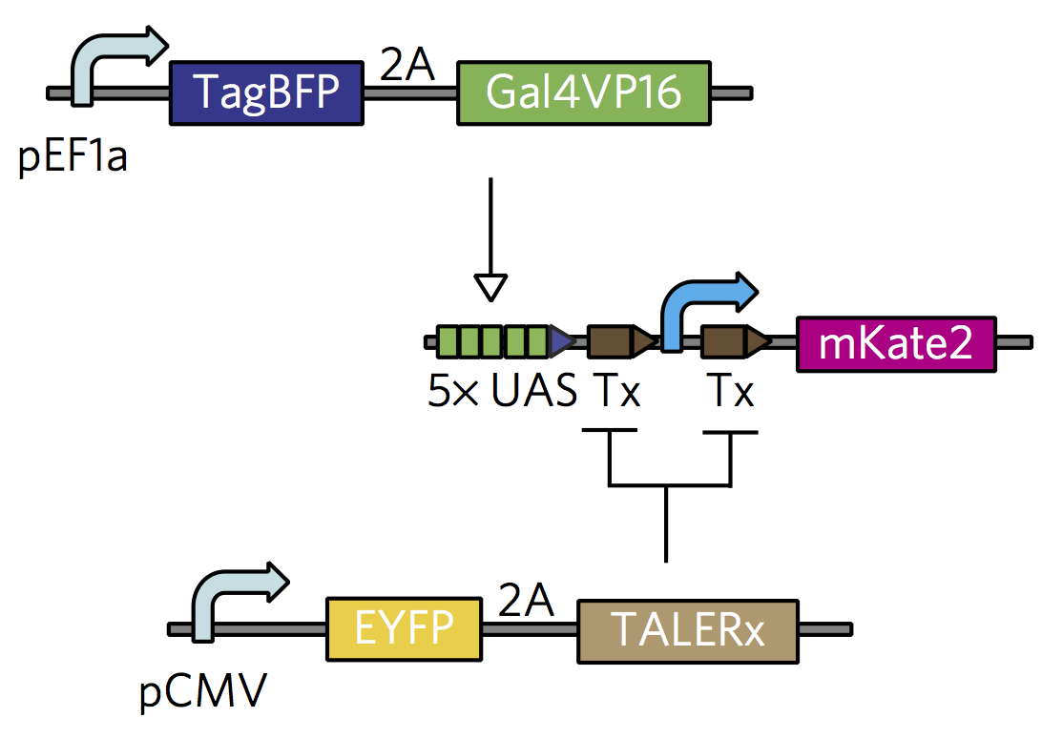
High-performance device libraries
Integrase Logic
~1000x on/off, good amplification
~1-5% non-responsive
→ ΔSNR<0
TALE Repressors
~1000x on/off, poor amplification
→ ΔSNR<0
CRISPR Repressors
~100x on/off, amplification ???
→ ΔSNR unknown
[Bonnet et al. 2013]
[Garg et al., 2012; Davidsohn et al.,
2015; Li et al., 2015]
U6
gRNA-a
pConst
cas9m-BFP
CRa-U6
EYFP
[Kiani et al. 2014; Kiani et al. 2015]

Slide 39
Summary
Automation-assisted workflows can yield dramatic improvements in organism engineering
Biological circuits can be “compiled” from high-level specifications of behavior
New biological devices, measurement, and modeling are starting to enable complex designs

Slide 40




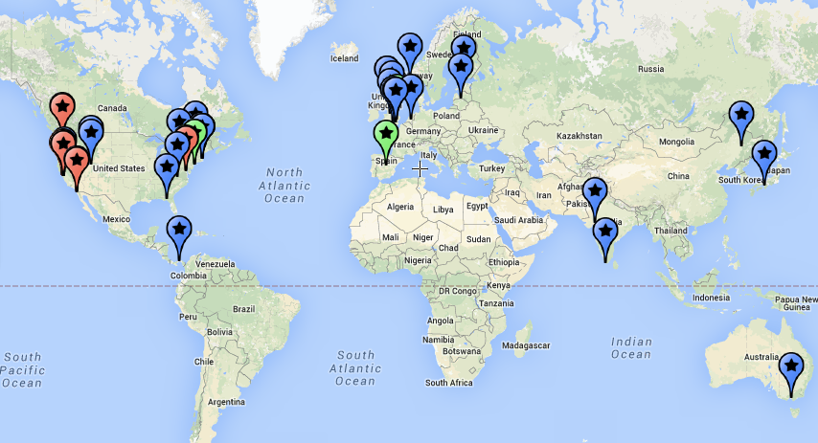


Acknowledgements:
Aaron Adler
Joseph Loyall
Rick Schantz
Fusun Yaman
Ron Weiss
Jonathan Babb
Noah Davidsohn
Mohammad Ebrahimkhani
Samira Kiani
Tasuku Kitada
Yinqing Li
Ting Lu
Douglas Densmore
Evan Appleton
Swapnil Bhatia
Chenkai Liu
Viktor Vasilev
Tyler Wagner
Traci Haddock
Kim de Mora
Meagan Lizarazo
Randy Rettberg
Markus Gershater
Jim Hollenhorst
Marc Salit
Sarah Munro
Zhen Xie

